Slide 1
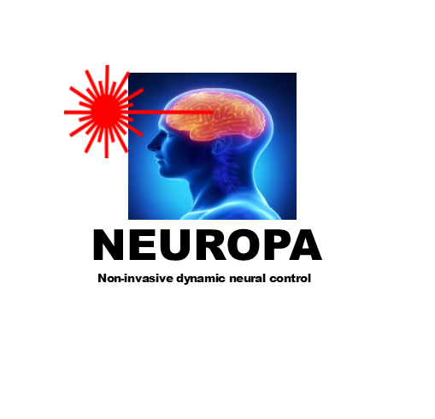
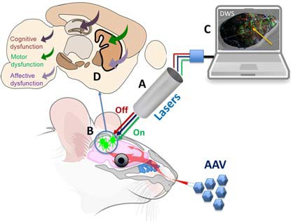
Whether it is in the development of novel phytochrome actuators……
Developing a compact laser platform to enable non-invasive skull penetrating IR stimulation of cortical areas……
Or utilising the latest cerebral blood monitoring system based upon diffusion wave spectroscopy….
NEUROPA leads the way…
NEUROPA – a new era for brain therapy
NEUROPA is a EU-funded project which aims to combine cutting-edge research from the new field of phytoptogenetics combined with two-photon laser technology for non-invasive long-term alleviation of brain dysfunction.
NEUROPA – a new era for brain therapy
Project Title: ‘Non-invasive dynamic neural control by laser-based technology
Call Topic: H2020 – FETOPEN – 2018-2020
A. Compact laser sources for non-invasive two-photon activation and deactivation (on/off) of phytochrome. B. Phytochrome cellular control and non-invasive selective AAV delivery to the brain. C. Compact non-invasive brain blood flow monitoring system. The system has two purposes. 1 – enable selective targeting of cortical area; 2 continual monitoring of brain activity. D. Phytochrome- induced modulation of specific cortico-sub-cortical network loops to restore motor, cognitive and affective disorder dysfunction in mouse models.
Within the duration of the project A, B, C and D will be combined to realise the Neuropa concept.
For more information visit:
www.neuropaproject.eu
Looking for more information?
Visit our website! www.neuropaproject.eu
Contact us via email! neuropa@dlmconusltancy.net
This project has received funding from the European Union’s Horizon 2020 Research and Innovation Programme under Future and Emerging Technologies grant agreement No. 713140.

Slide 2
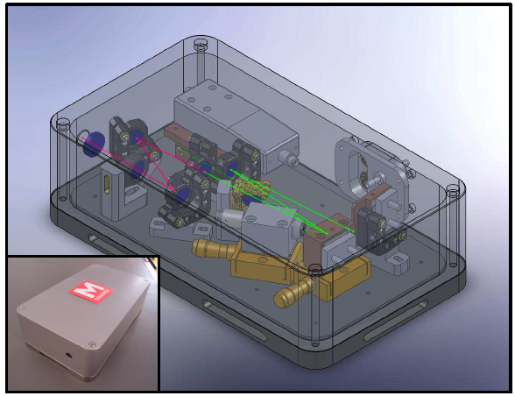
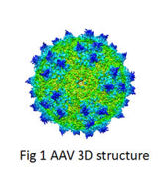
Why NEUROPA?
There is an enormous human toll of brain disorders in Europe, with an estimated 83 million people affected [1] and an estimated total cost of €798 billion [2]. This is a great healthcare and societal challenge for the countries of the EU and indeed, the world, which will be exacerbated by an increasingly ageing population.
precision. As a three-dimensional model, we allow neurons to grow as they would in vivo, making abundant connections that they are not able to form in a constrained 2D environment!
This will be achieved by two-photon (2P) activation of novel phytochrome actuators that control the expression of genes involved in synaptic plasticity. Developments in viral engineering will enable the targeting of brain phytochrome expression via peripheral exposure rather than direct brain injection. Ongoing development of brain-region and cell-specific gene delivery systems will enable expression in specific cell types i.e. excitatory neurons, inhibitory neurons and glial subtypes in targeted subpopulations within specific brain areas.
Phytoptogenetics is a new field of research and technology. We will develop a new class of phytochrome actuators that will be activated by 1000-1700nm pulsed laser wavelengths and selectively control gene expression for long term neuronal network modulation. The bi-stable nature of phytochromes will enable control of the degree and duration of activation.
AAV- mediated gene delivery advances will first deliver engineered AAVs encoding phytochromes via intravenous infusion to obtain wide-spread phytochrome expression in the brain, we will also design a new set of AAVs to target the cortex via intranasal instillation.
Diffusion wave spectroscopy based blood detection will enable the monitoring of network activity and hence the interactive control of the photo-switchable phytochromes.
AU | aston.ac.uk Aston University
Birmingham, GB
UBT| uni-byareuth.de Universitaet Bayreuth
Bayreuth, DE
The NEUROPA project will develop a conceptually novel non-invasive theranostic approach. We will develop a non-invasive system, which modulates long-term activity in specific cortico-sub-cortical networks implicated in specific brain disorders, Huntington’s (HD) and cognitive impairment in Alzheimer’s (AD) disease.
UOULU | oulu.fi Oulun Yliopisto
OULU, FI
UB | ub.edu Universitat de Barcelona
Barcelona, ES
PHI | pharmacoidea.eu Szeged, Hungary
SU | sorbonne-universite.fr Paris, France
DLM | dlmconsultancy.net DLM Consultancy Services
Edinburgh, Scotland
NEUROPA will lead to the development and widespread use of mobile-phone-sized, reliable, and affordable bio-photonic system(s), which will non-invasively and selectively dynamically control specific brain networks in different dysfunctional states.
For more information visit:
www.neuropaproject.eu

